Slide 1
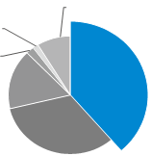
Pursuing Doctoral Studies
Benefits
Developing your logical thinking, critical thinking ,and problem-solving skills, and enabling you to understand the process of creating new value
Training your creativity, while providing the enjoyment of research and a broad perspective on technology in relation to society
Helping you gain self-confidence to work independently regardless of field, a wider range of career path options, and greater chances of finding satisfying and rewarding jobs and success.
Changes in the perception of doctoral degrees
First occupations for science and engineering doctoral graduates
With the goal of taking advantage of scientific and technological progress, and developing capabilities for creating new industries, the expectations for individuals with doctoral degrees are growing. Their advanced sci-tech knowledge, as well as problem-finding and -solving skills are sought after by society.
After completing doctoral programs, a wide range of career paths can be considered – doctoral graduates work as scientists at higher education or research institutions, active players in companies, entrepreneurs, bureaucrats, politicians, etc. In particular, they are becoming more active in R&D companies.
Others
Office Workers
Other Professionals &
Technical Workers
Researchers
Teaching
Staff
Engineers
Source:
MEXT-NISTP “Japanese Science and Technology Indicators 2021”
Related information: 「博士」 のすゝめ* https://www.tac-mi.titech.ac.jp/pdf/hakasenosusume.pdf
* Roughly translated as “Benefits of earning doctoral degrees”
Notes:
Completing a doctoral degree program will help you gain self-confidence and independence while expanding your career path options. You will be able to develop your logical thinking skills and understand the process of creating new value. You will learn how technology is interconnected with society from a broad perspective.
Doctoral graduates are increasingly sought after by society, in view of scientific and technological advancement and the need to develop capabilities for creating new industries.
We encourage you to consider opportunities for pursuing doctoral degrees at Tokyo Tech.

Slide 2
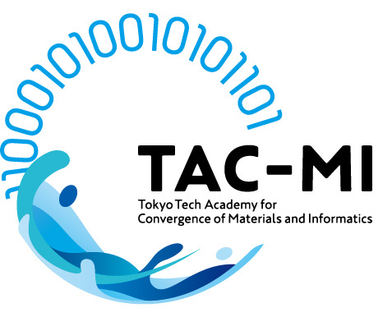


Three Takuetsu Programs
Financial support for doctoral students
At Tokyo Tech, almost all doctoral students receive financial support from public or private entities. The TAC-MI, WISE-SSS, and ISE academies engaging in Takuetsu programs offer students opportunities for financial support.
Takuetsu programs and academies
As part of efforts to foster outstanding doctoral graduates, Tokyo Tech has established the aforementioned three academies that function across academic disciplines at the Institute, and enable seamless transition between master’s and doctoral degree programs. With the objective of developing students’ abilities and skills required to create new value and solve social problems, these academies offer unique programs. They aim to promote interdisciplinary research, and encourage personnel exchanges among various organizations such as industrial entities, national institutions, and overseas institutions, while placing value on laboratory work and activities.
Takuetsu programs are waiting to welcome you!
Tokyo Tech Academy for Convergence of Materials and Informatics (TAC-MI)
Tokyo Tech Academy for Super Smart Society (WISE-SSS)
Tokyo Tech Academy of Energy and Informatics (ISE)
* Takuetsu programs: Programs offered by the TAC-MI, WISE-SSS, and ISE academies are supported by MEXT’s Doctoral Degree Program for World-leading Innovative & Smart Education (WISE Program). They are commonly called Takuetsu (卓越 in Japanese, meaning excellence or superiority) programs.
Notes:
TAC-MI, WISE-SSS, and ISE are offering financial support opportunities targeting doctoral students, in accordance with Tokyo Tech’s efforts to help students financially.
These academies function across academic disciplines at Tokyo Tech, and enable seamless transition between master’s and doctoral degree programs. With the objective of developing students’ abilities and skills to create new value and solve social problems, they offer commonly called Takuetsu programs. They intend to promote interdisciplinary research and encourage personnel exchanges among various organizations.
We hope that you will take advantage of the opportunities available to you through Takuetsu programs.

Slide 3



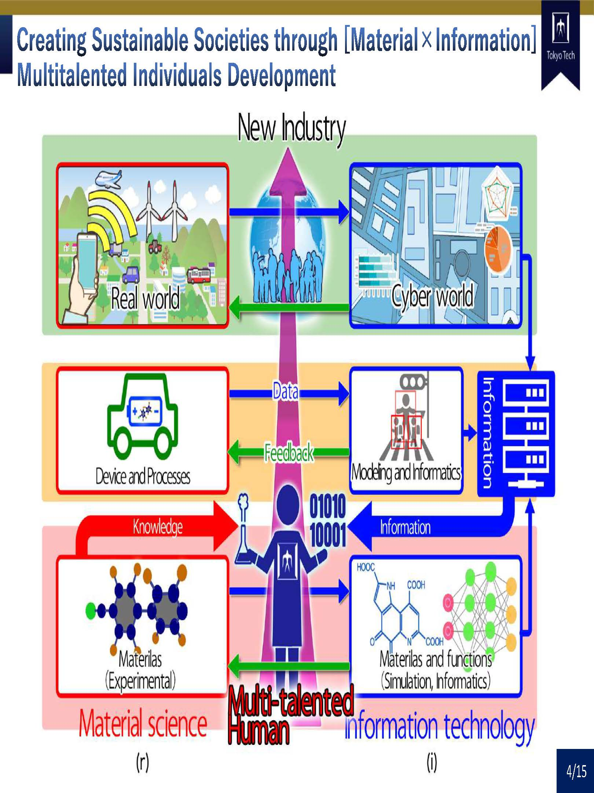
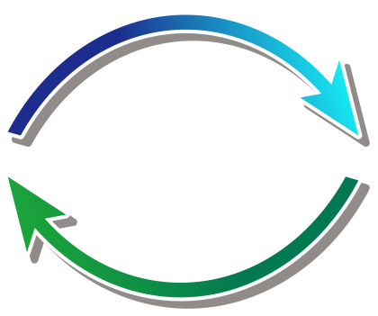
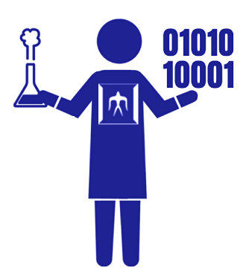
Tokyo Tech Academy for Convergence of Materials and Informatics (TAC-MI)
Creating sustainable societies
through [Material×Information]
multi-talented human resource development
Materials and devices
Information technologies
Fusion
Fusion between material science and information technologies based on Tokyo Tech’s own research centers, such as Center for Element Strategy and TSUBAME super computer
Tokyo Tech Academy for Convergence of Materials and Informatics (TAC-MI) Start!
Services
Infor-
mation
Materials
Creating new industries
by connecting “materials", which is Japan's strengths, to “services" by utilizing information science & technologies.
Produce leaders who create new industries
as advanced professionals in materials science and informatics
Notes:
＜About TAC-MI＞
In order to foster outstanding individuals, The Tokyo Tech Academy for Convergence of Materials and Informatics (TAC-MI) began operating in January 2019 under the auspices of MEXT’s WISE Program.
While in their graduate studies, students pursuing a doctoral degree can take this additional program, which will enable them to connect information with materials by using information science and multifaceted thinking, as well as by taking a broad perspective.
The program aims, in addition to the top-level researche, to cultivate Multitalented Individuals to become leaders in this “space in multi-axes” that is our continuously advancing society.
“Multitalented Individuals” mean those capable of creating new industries by connecting “materials", which is Japan's strengths, to “services" by utilizing information science & technologies.
Such individuals can innovate not only materials design and production processes but also the services necessary for society.
Consequently, multitalented individuals can devise new industries that contribute to a sustainable society and create new areas of study.

Slide 4
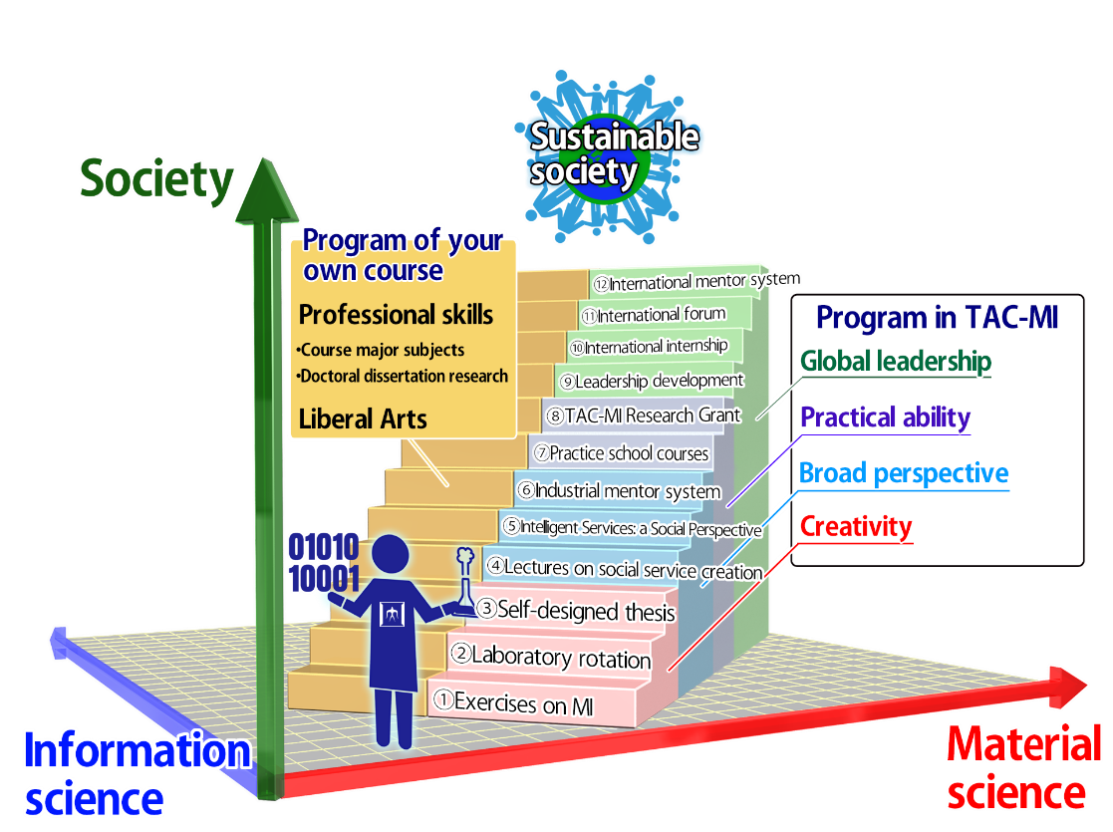
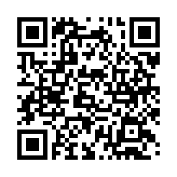
Specially offered degree programs for TAC-MI students
To help students develop the four attributes required to become multitalented individuals, the academy has designed 12 educational modules:
(1) Creativity
・ Materials and Informatics lectures with exercises
・ Laboratory rotation
・ Originality education with Self-designed thesis
(2) Broad perspective
・ Lectures on social service creation
・ Intelligent Services: A Social Perspective
・ Industrial mentor system
(3) Practical ability
・ Practice School to solve companies issues
・ TAC-MI Research Grant to enhance the ability
to find and solve problems
(4) Global leadership
・ Leadership development courses provided by ToTAL
・ International internships
・ International forums on materials and informatics
・ International mentor system
We also offer the TAC-MI Scholarship and RA that helps TAC-MI students to be financially independent and allows them to concentrate on their studies.
Student Recruitment Briefing will be held online. Please participate in the briefing session！
April 27th ,2022 To be live-streamed using Zoom
① 16:30～17:15 Explanation in English
② 17:15～18:00 Explanation in Japanese
③ 18:00～19:00 Exchange Meeting with TAC-MI Students
Schedule
If you wish to participate in the briefing session, please register from the TAC-MI website.
https://www.tac-mi.titech.ac.jp/en/event/ay2022fall-briefing/
Notes:
＜Program Overview＞
Cutting-edge facilities such as the Materials Research Center for Element Strategy and the supercomputer TSUBAME, combined with the Institute’s collective strength, will allow TAC-MI students to acquire the following four attributes necessary to become multitalented individuals , as well as experts in materials science and information science:
(1) Creativity: Ability to create methods and ideas involving materials science and information science
(2) Broad perspective: Ability to extract an essence by sifting through vast amounts of information, identify issues, and set goals
(3) Practical ability: Ability to design and manage projects, spiraling outward and expanding from the atomic or molecular level to social innovation
(4) Global leadership: Ability to lead a diverse team, and to take the initiative in setting and implementing visions on a global scale
The academy has designed 12 educational modules to help students develop the desired attributes as multitalented individuals.
In addition, we also offer the TAC-MI Scholarship and RA that helps TAC-MI students to be financially independent and allows them to concentrate on their studies.
＜AY2022 Fall Semester Student Recruitment Briefing＞
TAC-MI will begin recruiting students starting in Fall Semester 2022.
AY2022 Fall Semester Student Recruitment Briefing will be held online.
If you wish to participate in it, please register from TAC-MI website.

Slide 5

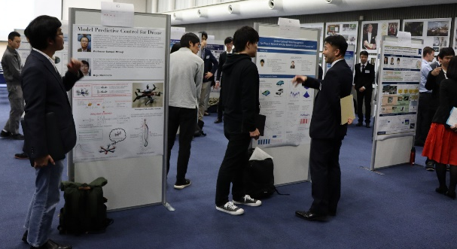
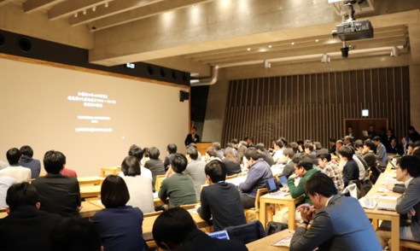
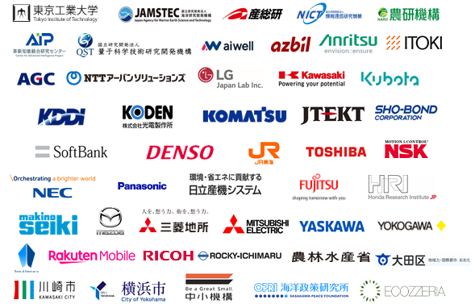
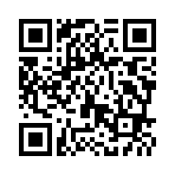
Super Smart Society (SSS) Promotion Consortium
A next-generation education and research platform has been established!
Students have opportunities to form interdisciplinary research teams with consortium partners and participate in the team with financial support.
SSS matching workshop
But, how?
Match the needs of the Consortium partners with the seeds of the research and human resources of students through mutual presentations and discussions
Matching results
2020: 35 cases 2021: 18 cases
Next chance is coming soon!
June 6 (Wed) … Seeds from students
June 29 (Wed) … Needs from industry
All of you are eligible
for attending.
Register now on the web!
Notes:
Super Smart Society Promotion Consortium established in 2018 has built a next-generation education and research platform through tight collaboration with industry.
The consortium provides all graduate students with opportunities to form interdisciplinary research teams on students’ own initiative, and work with consortium partners listed below having sufficient financial support. To this end, you are strongly encouraged to participate in Matching Workshop. The workshop matches the needs of the Consortium partners with the seeds of the research and human resources of students through mutual presentations and discussions. Actually, 18 matchings were formed in 2021 and some students are now conducting advanced researches with financial support from RA expenses. The next workshop is scheduled on June 8th and 29th . All of you are eligible for attending. Please register on the web.

Slide 6


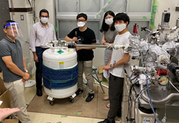
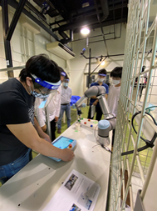
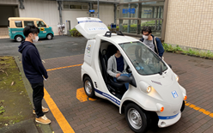
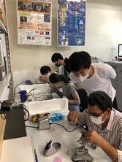
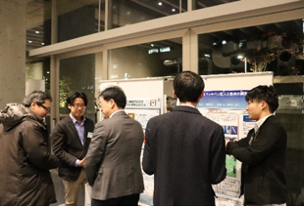
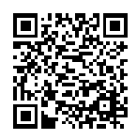
WISE for Super Smart Society (since Apr. 2020)
↑WISE Introduction Video
Opportunities for education and advanced research using multiple research & education fields that bring together the best of cutting-edge science and technology
Unique educational programs in cooperation with industry
Substantial financial support
Register now
on the web!
Join us at the Briefing Session for Student Recruiting!
Notes:
太字を読み上げて頂ければと思います。

Slide 7
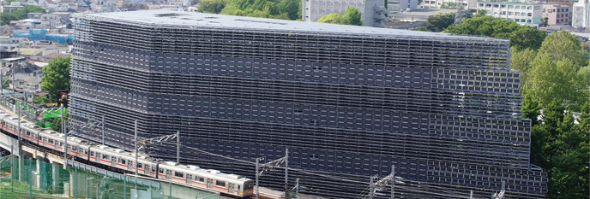


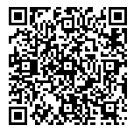
Features
Integrated Master’s and Doctoral program
Financial support
up to 2.53 million yen/year
Open for all courses
2014年日本建築学会作品選奨受賞
Tokyo Tech Academy of Energy and Informatics
Multi-scope・Energy WISE Professionals
Briefing Session on Recruiting Students
for 2022AY Spring Enrollment
DATE ：April 7th, 2022 (Thu）
JPN 16:30-17:30
ENG 17:45-18:45
Venue：Online by Zoom
Register here→
HP: https://www.infosyenergy.titech.ac.jp/Academy/
Feel free to attend the session!!
Notes:
Tokyo Tech Academy of Energy and Informatics provides an excellent educational program for Multi-Scope ・Energy WISE Professionals,
which is an integrated Master’s and Doctoral program.
Along with progressing your research study, you will be able to become an expert who can design a groundbreaking energy society
and drive the forces of innovation by mastering our program.
New master’s students in 21AY fall can apply to our academy in 22AY Spring enrollment.
After listening to our guidance, if you have any interests in our program,
please feel free to attend the briefing session for both new master’s and doctoral students held in late afternoon on April 7th.
Now, we will show you the outline of our program.
（Next page）

Slide 8

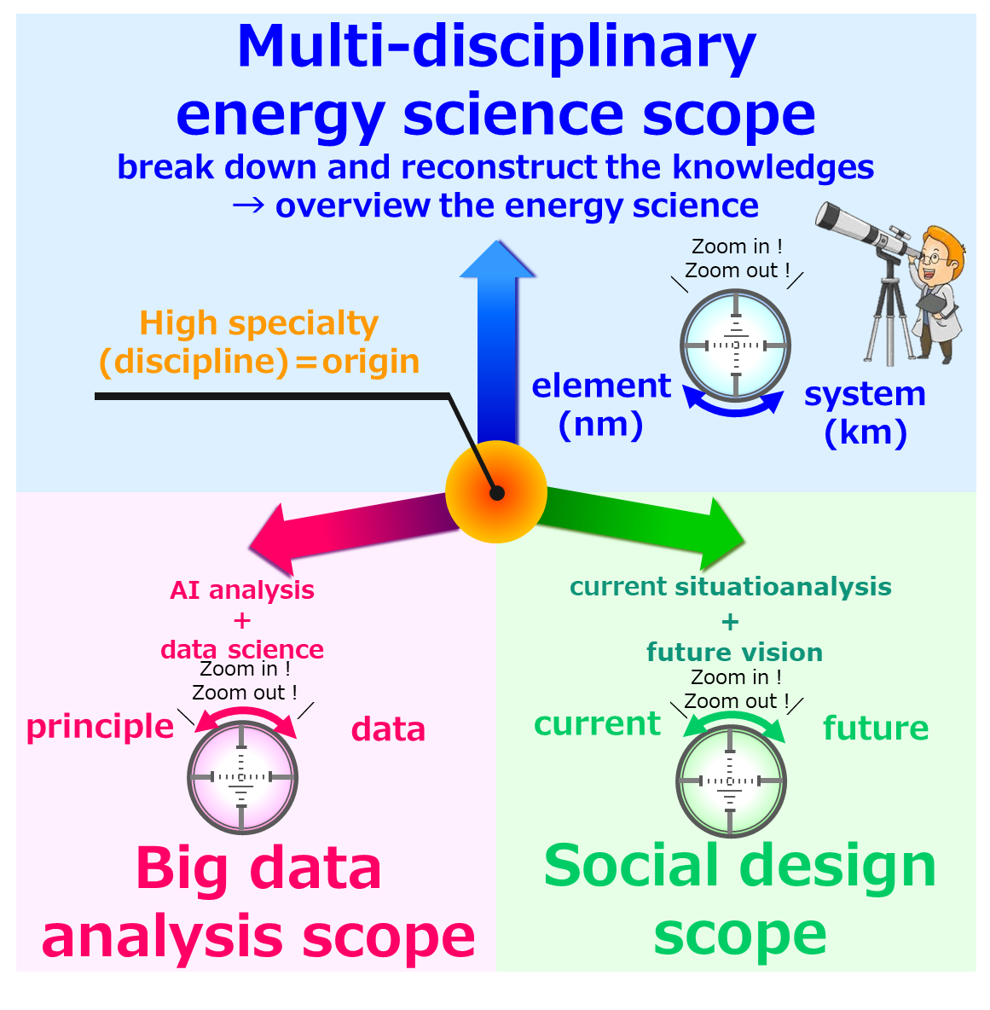
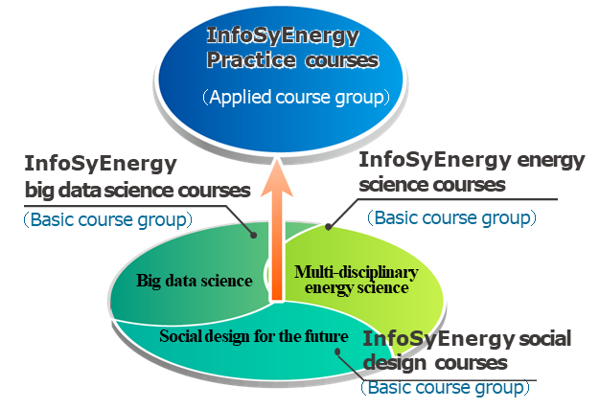

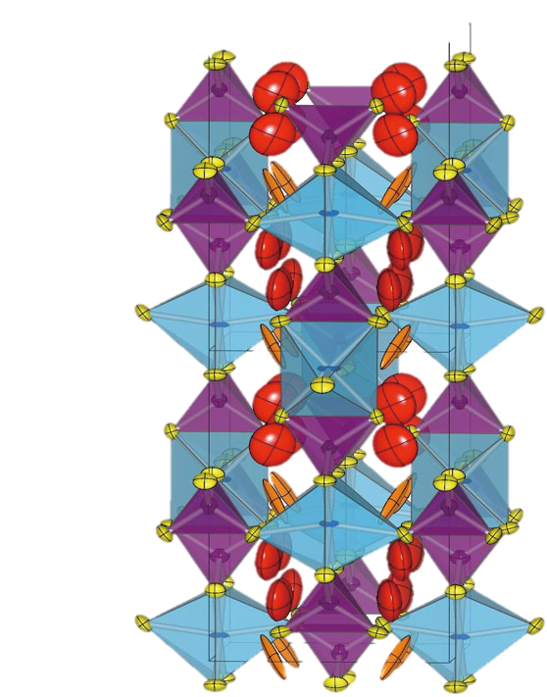
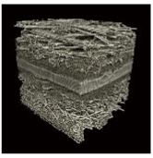
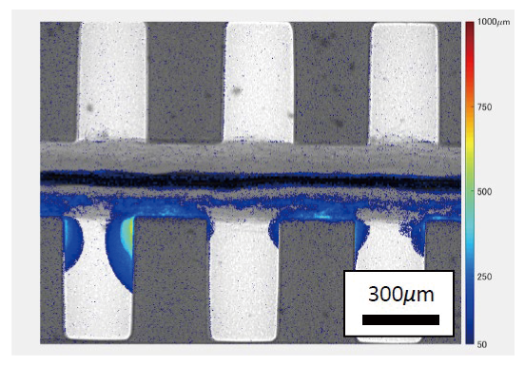
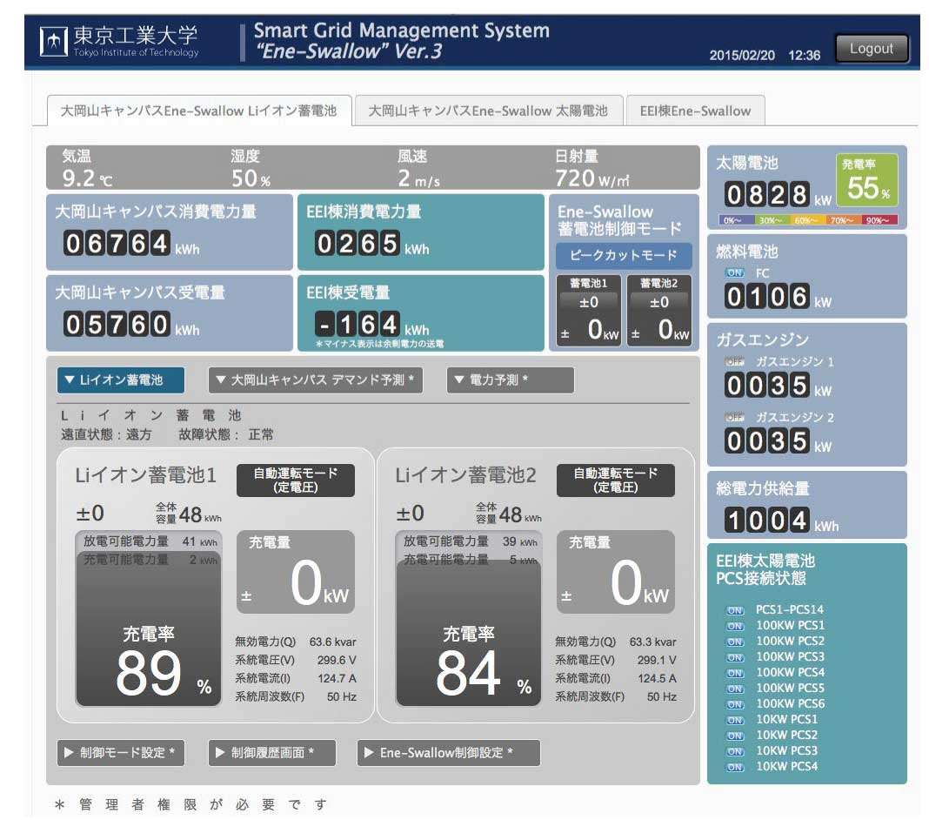
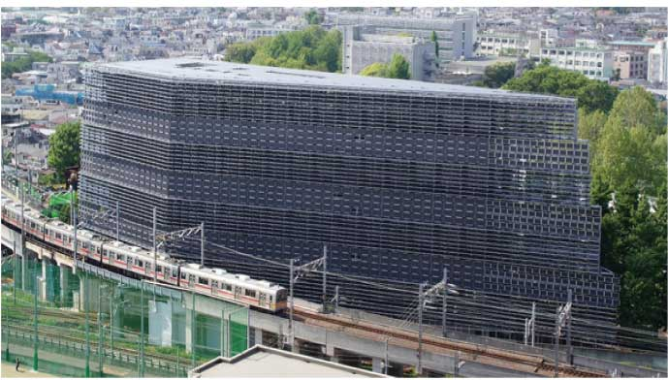

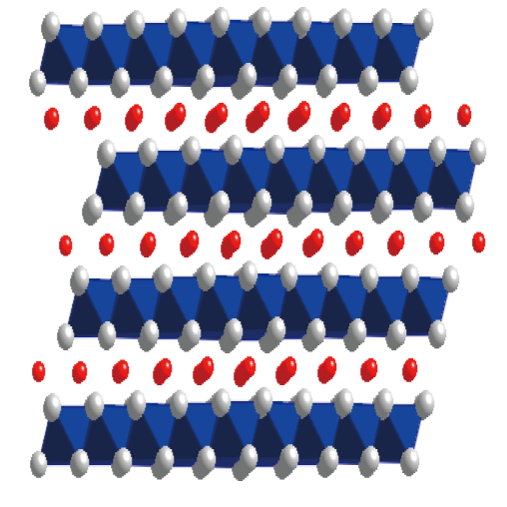

Outline of Tokyo Tech Academy
of Energy and Informatics
“Professionals” with “Multi-disciplinary energy science scope” applied by
“Big Data Science”（AI analysis+Data science）who can design a new sustainable energy
Expectations
＝
Create, design and lead the future society
Multi-Scope・Energy WISE Professionals
Our Efforts
Our Curriculum
Hitotsubashi University’s cooperation by providing knowledges of social science, educational skills and professional skills
Utilization of energy big-data in smart energy system developed and demonstrated at Tokyo
Collaboration with consortium members of 25 companies, 6 public institutes and 15 world’s leading universities
Cultivating abilities of flexibly handling on the site and finding problems by providing internship and co-research programs with domestic/overseas companies and universities
Constructing a global human network centered on doctoral students by participating in various events such as cutting-edge research workshops and exchange events with consortium member companies and overseas universities
The business and international mentorship system will help students develop multifaceted viewpoints
Cultivate “3 scopes” by “4 course groups” collaborating
with “InfoSyEnergy Research and Education Consortium”
多元的
エネルギー学理
社会構想
The Aim of InfoSyEnergy
Over 70 Professors/Assoc. Professors participating from across all of Tokyo Tech’s schools
Organized into nine areas, teams design and conduct collaborative research
“Multi-scope” energy education through academia-industry cooperation
Strategic student-industry matching, and a recurrent education system
「Synergistic effects from integrated promotion of "energy device development" and "system development
Promote the integrative researches of “system” and “devices”
Campus system technology developed and demonstrated at Tokyo Tech
Companies
Public institutions
World’s top universities
Various energy devices and elemental technologies of Tokyo Tech
25
6
15
Solid-state batteries
Electrolysis(H₂)/fuel cells
Solar cells
Distributed Energy system
Tokyo Tech
Notes:
Currently, world trend goes toward low-carbon and decarbonized energy society.
To implement such society, we need professionals who have diverse capabilities
such as having deep knowledge of energy, utilizing informatic science and being versed in economy and policy making.
Our academy provides a curriculum for mastering such capabilities
to train students who will become professional leading the formulation of new social and industrial platforms.
We cultivate “3 scopes” by “4 course groups” collaborating with “InfoSyEnergy Research and Education Consortium”.
Firstly, students will master “Scientific Principle of Energy” which is the core of our program,
“Big-Data Science” which is a state-of-the-art genre such as AI analysis and
“Social Design” which is the knowledge for analyzing current situation of our society,
designing a future society and leading a future society.
Next step will be the stage where students can experience the frontline of the your major
with world’s top universities and companies so that they will be able to construct
your own network with them globally.
In addition, you can learn the latest studies from leading professionals in the specific field.
After completion of our curriculum, you will become a professional to lead the new energy society of the future
in expected scenes such as venture companies, a new business department in a company and universities and research institutions.
Here is a condition to enroll in our academy that students will go on doctoral program.
We have a financial aid system for doctoral students of our academy to be financially independent
and concentrate your research study.
If you consider going on a doctoral program, please remind of enrollment in our academy as well.
For the rest of them, it might be worthy to think of enrolling in our academy to improve the social value of your research.
We are looking forward to you registering to our academy.

